Slide 1
Meningococcal vaccination in the UK – C, B and W
Prof. David M Salisbury CB FRCP FRCPCH FFPH FMedSci
Centre on Global Health Security, Royal Institute of International Affairs, London
Declaration of Interest: DMS has acted as a paid consultant to vaccine manufacturers.

Slide 2
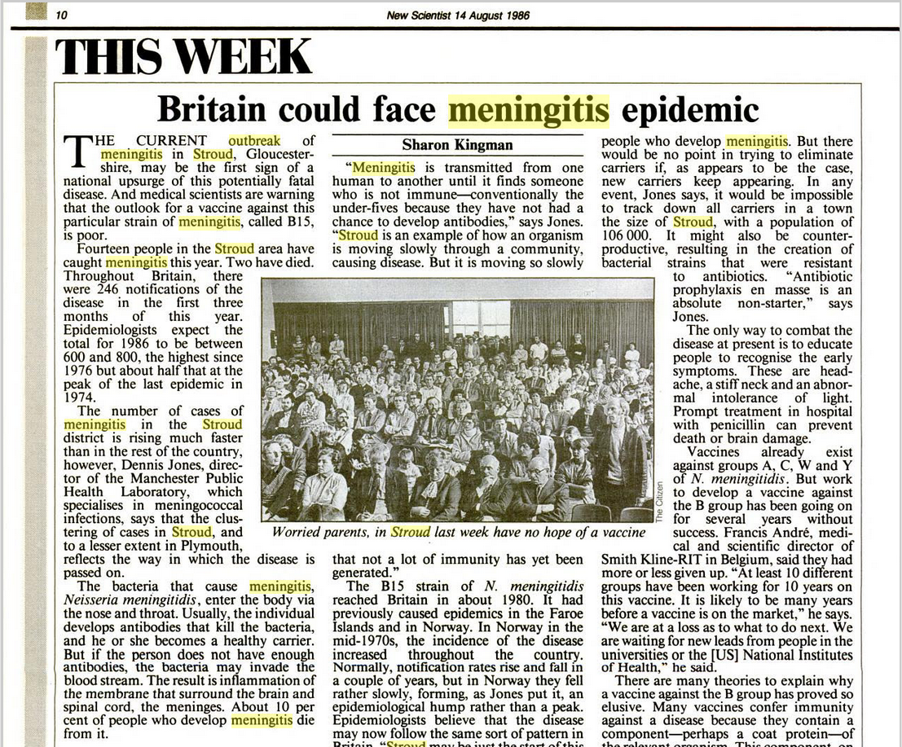

Slide 3
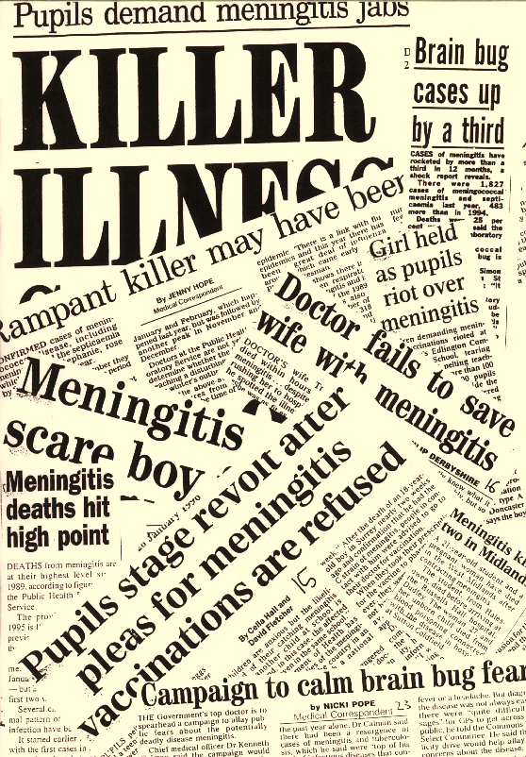

Slide 4
Laboratory confirmed Group B and C meningococcal disease,
England and Wales,
July 1994 – 1999 (PHLS data).

Slide 5
Deaths from Meningococcal disease by age,
1994 – 1999, E & W (PHLS data).

Slide 6
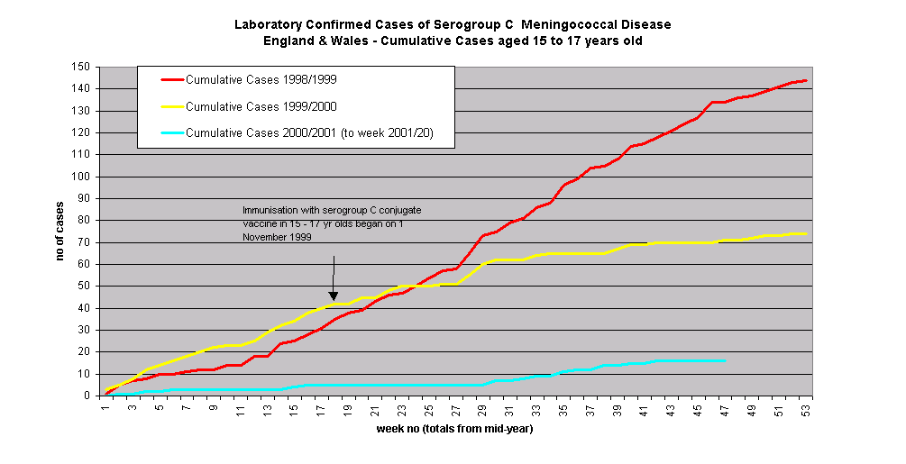

Slide 7
Introduction of Meningococcal C vaccine in the UK.

Slide 8
Reduction in Men C incidence in unvaccinated groups by age
July 2001−June 2002 vs July 1998−June 1999
Age scheduled for MCC |  | Rate per 10⁵ pre-MCC campaign |  | Rate per 10⁵ post-MCC campaign |  | % Reduction (95% CI)
15-17 yrs |  | 5.28 |  | 1.79 |  | 66 (37 to 82)
11 to 14 yrs |  | 5.54 |  | 1.11 |  | 80 (46 to 93)
9-10 yrs |  | 1.69 |  | 1.30 |  | 23 (-228 to 82)
5-8 yrs |  | 2.07 |  | 0.87 |  | 58 (-35 to 87)
2 to 4 yrs |  | 3.94 |  | 1.20 |  | 70 (30 to 87)
1 yr |  | 6.82 |  | 2.05 |  | 70 (-24 to 93)
Infant catch-up |  | 7.49 |  | 1.56 |  | 79 (-54 to 97)
Overall |  | 4.08 |  | 1.36 |  | 67 (52 to 77)
Ramsay ME, Andrews NJ, Trotter CL, et al. BMJ 2003;326(7385):365-6.

Slide 9
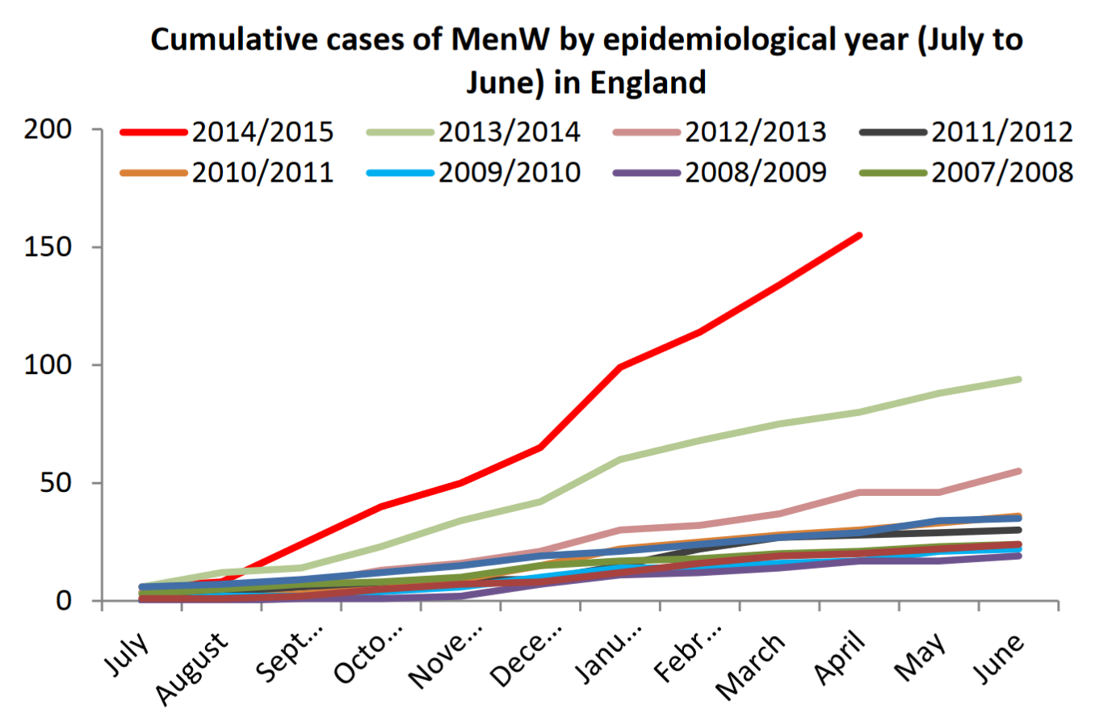

Slide 10
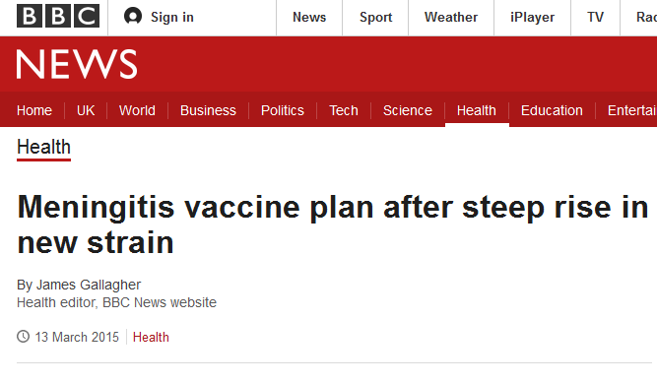
Teenagers will soon be vaccinated against deadly meningitis W after a steep rise in the number of cases, Public Health England has announced.
There were 22 confirmed cases in 2009, 117 last year and experts predict even more cases in the future.
Meningitis W also has a higher-than-usual death rate.
The government's Joint Committee on Vaccination and Immunisation called for 14 to 18-year-olds to be vaccinated "as soon as possible".

Slide 11
Group B meningococcal disease

Slide 12
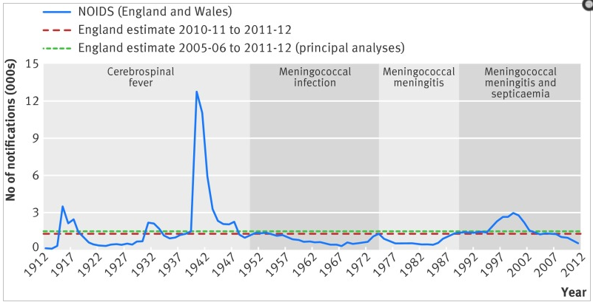
Number of cases of meningococcal disease over time in England and Wales. Principal data from Notifications of Infectious Disease (NOIDS) for England and Wales, with sections indicating diseases reported during different time periods.
Re-evaluating cost effectiveness of universal meningitis vaccination (Bexsero) in England: modelling study.
Christensen H, Trotter CL, Hickman M, Edmunds WJ. BMJ. 2014 Oct 9;349:g5725. doi: 10.1136/bmj.g5725

Slide 13
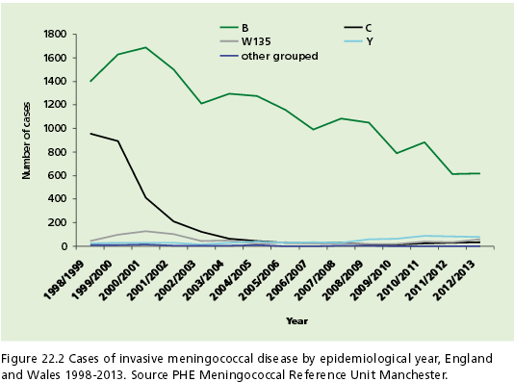

Slide 14
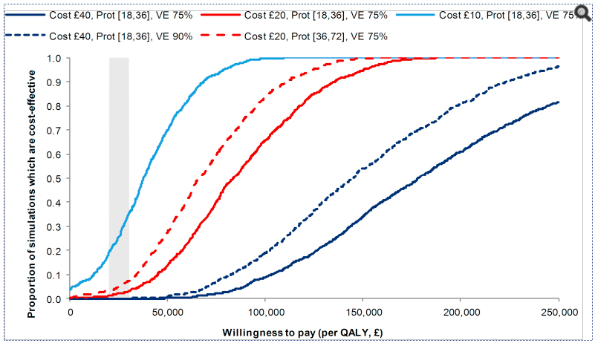
Cost-effectiveness acceptability curves for the cohort model in scenarios analyses. Curves show results under routine infant vaccination (strategy A) of the effect of varying cost (per dose) of the vaccine, vaccine duration of protection (given in months following the priming and booster doses) and vaccine efficacy (VE).
Vaccine. 2013 May 28;31(23):2638-46. doi: 10.1016/j.vaccine.2013.03.034. Epub 2013 Apr 6.
Introducing vaccination against serogroup B meningococcal disease: an economic and mathematical modelling study of potential impact.
Christensen H1, Hickman M, Edmunds WJ, Trotter CL.

Slide 15

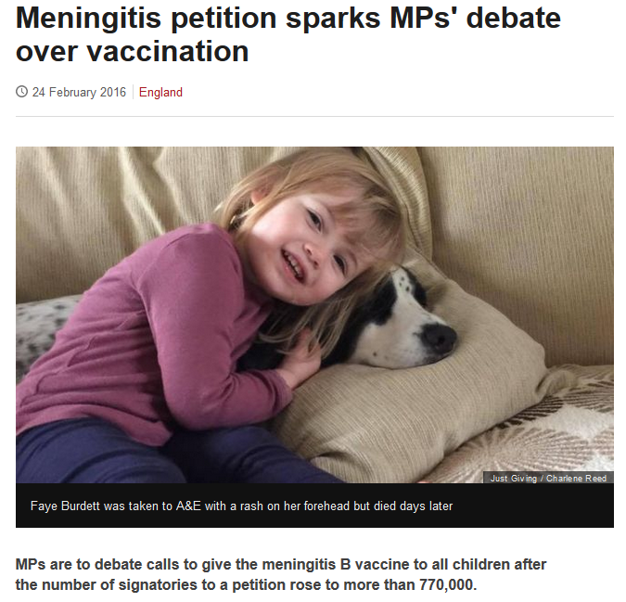

Slide 16
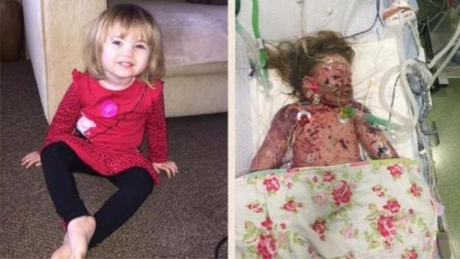
The petition, which is now the most-signed online petition in parliamentary history, calls for the vaccination of all children up to at least the age of 11.

Slide 17
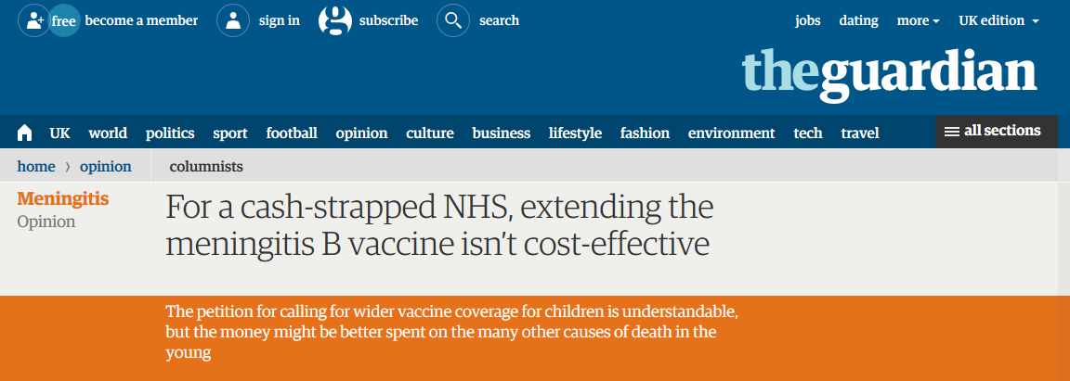
Sarah Wollaston, a doctor and senior Tory MP, said: “This is a very serious condition but if we’re to run vaccination policy purely on the size of a petition then we would run ourselves into very difficult territory.”
However, she added that there was a “case to review the formula that is used to weigh up cost-effectiveness and I think that is what should now happen”.

Slide 18
Paying for vaccines requires hard decisions, especially when subject to the full glare of public scrutiny.
There is no easy solution.
Each case will be debated, settled, and judged on its own merits.
For meningitis B vaccination, it seems this particular debate is, for now, over.
http://dx.doi.org/10.1016/S1473-3099(16)00139-0

Slide 19
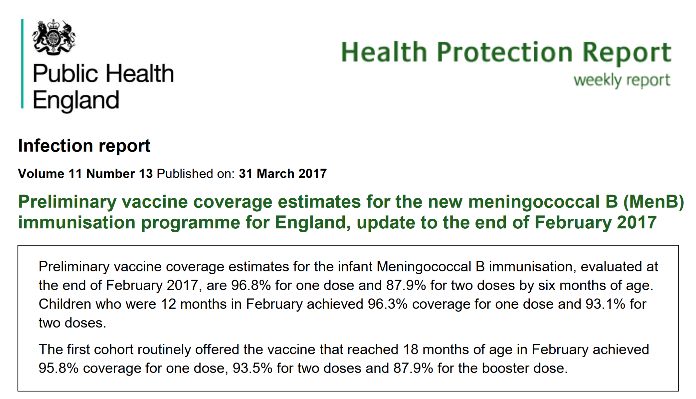

Slide 20
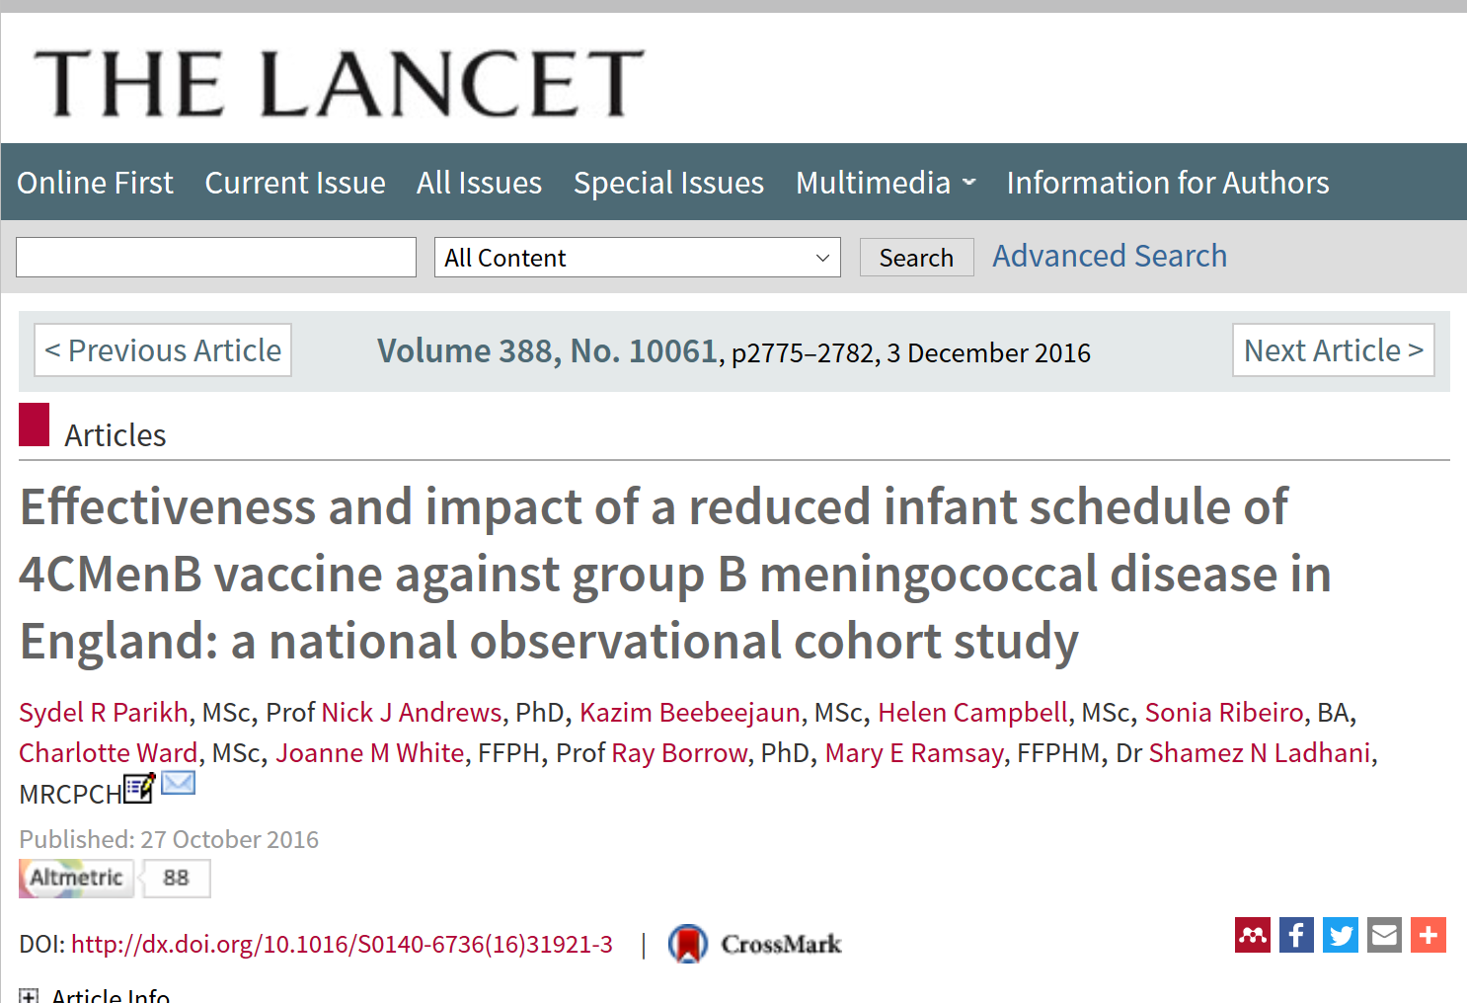

Slide 21
Compared with the pre-vaccine period, there was a 50% incidence rate ratio (IRR) reduction in MenB cases in the vaccine-eligible cohort (37 cases vs average 74 cases; IRR 0·50 [95% CI 0·36–0·71]; p=0·0001), irrespective of the infants’ vaccination status or predicted MenB strain coverage.
Similar reductions were observed even after adjustment for disease trends in vaccine-eligible and vaccine-ineligible children.

